Slide 1
Facebook Marketplace Seller Behaviour Analysis
Using Engagement Metrics and Machine Learning to Analyse Seller Performance.
DIVYAM
(First Year Student at IIT Guwahati, CSE Department)

Slide 2

Data Preprocessing and Cleaning
Overviewed 7050 instances of Facebook posts from Thai retail sellers.
Cleaning: Removed four redundant empty columns (Column1 to Column4)
Feature Engineering: Converted status_published to date time to extract Hour and the Day of the week.
Normalisation: Applied StandardScalar to ensure clustering model is not biased by large numbers.

Slide 3
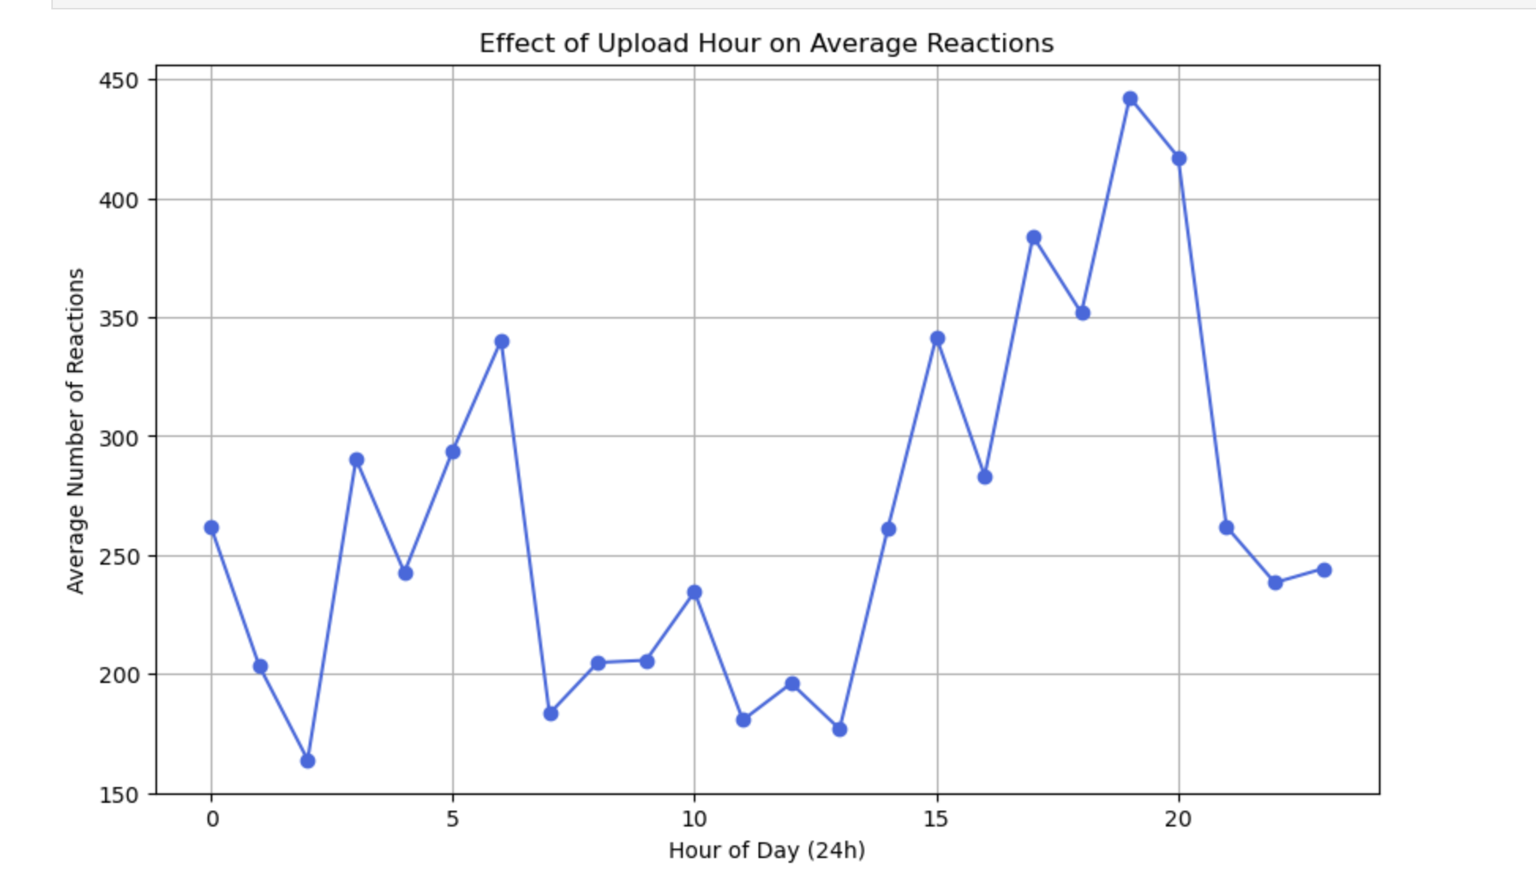
Impact of Upload Times on Reactions
Reactions are not uniform throughout the day.
There is a peak of reactions approximately from hours 18 to 21, suggesting that the audience is free mainly after the working hours.

Slide 4
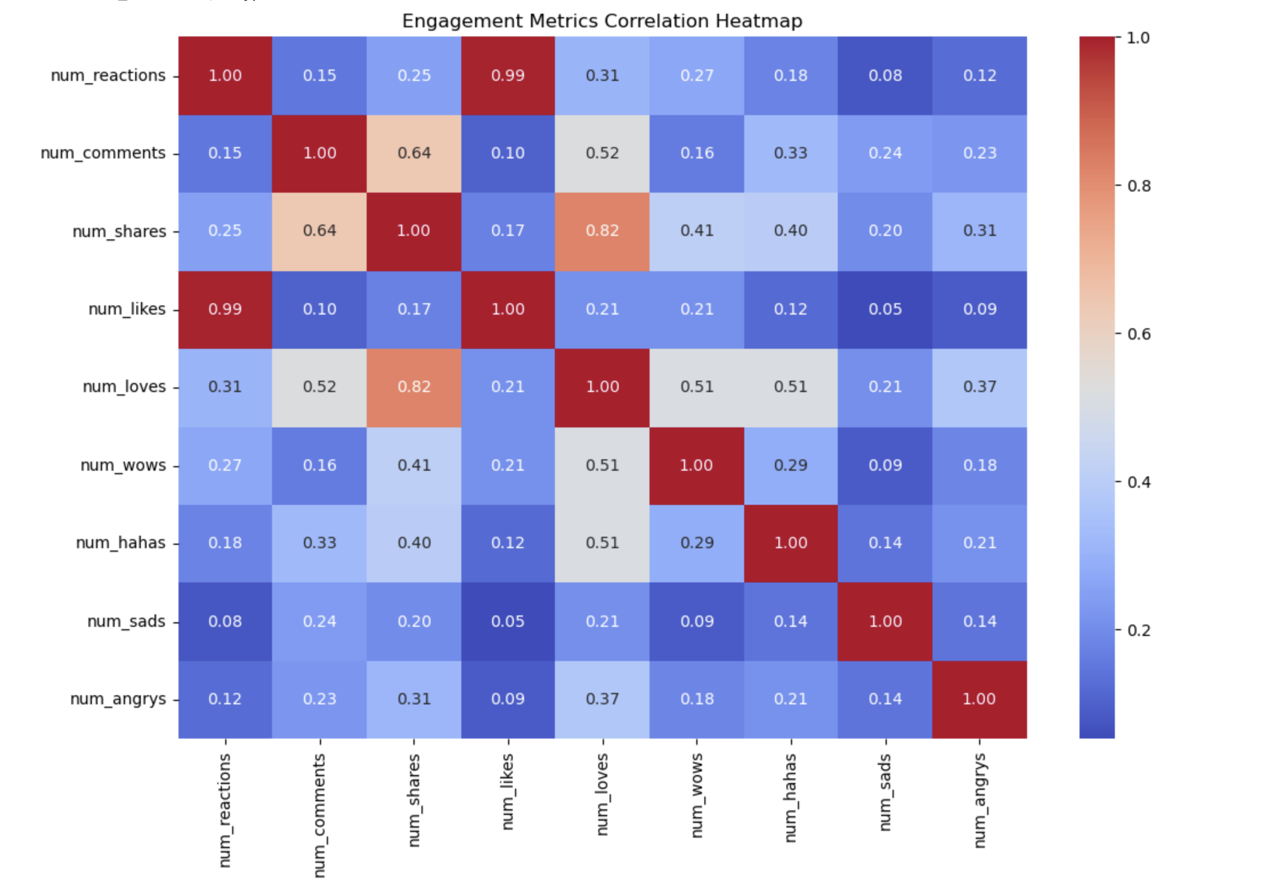
Engagement Correlations
There is near perfect correlation (0.99) between num_reactions and num_likes.
num_loves (0.31) and num_shares (0.25) show moderate positive correlation with num_reactions.

Slide 5
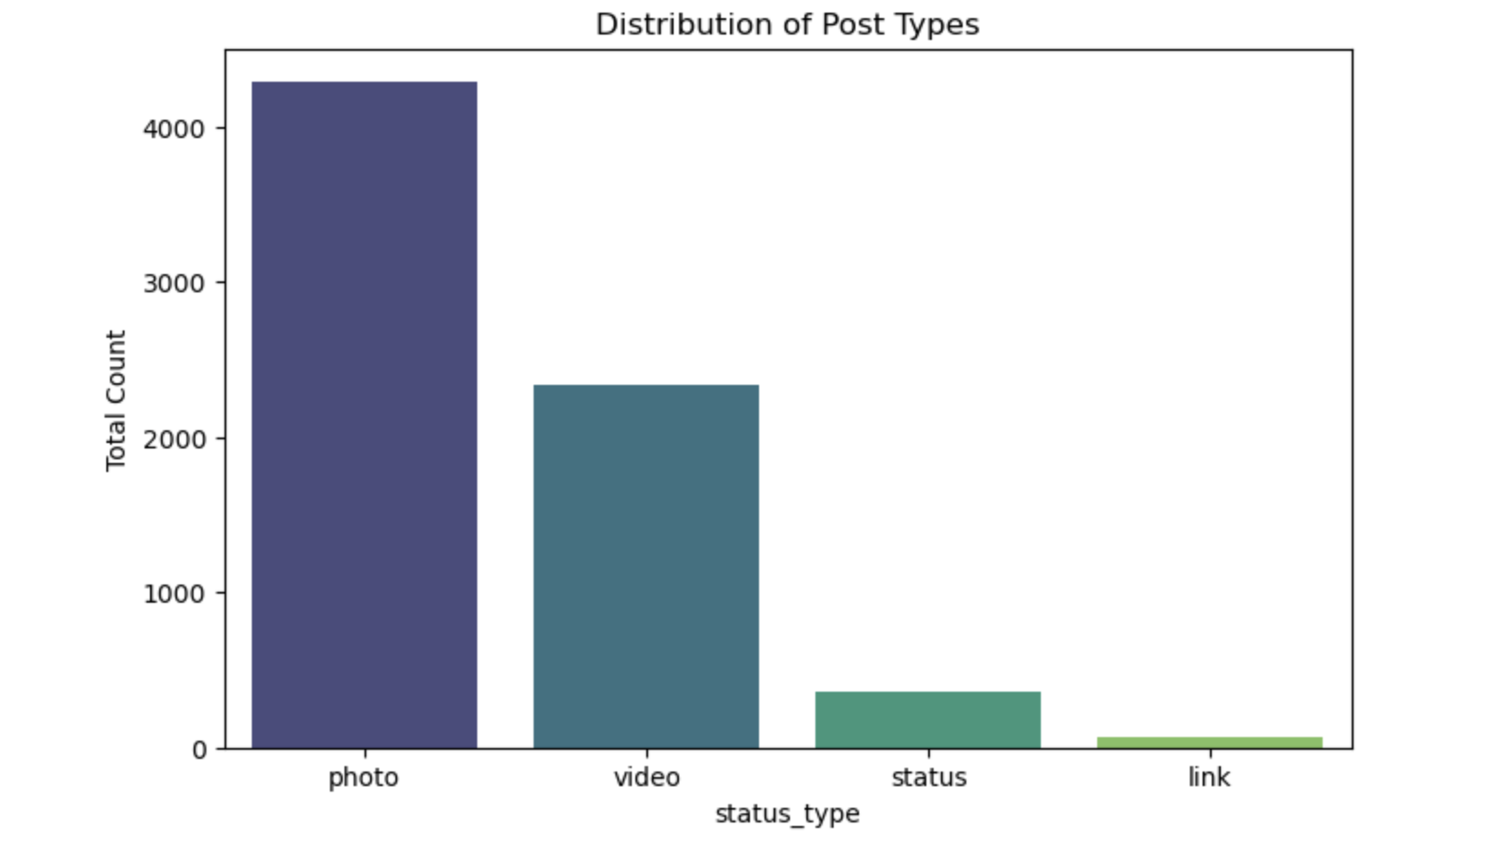
Distribution of Post Types
Photo is the most common post type.
Video is the second most frequent, whereas status and link are less frequent.
Can say sellers rely majorly on visual content like photos and videos.

Slide 6
Average Metrics per Post Type
Video generates highest number of comments and shares. So, we can say that video is better for interaction.
Status updates usually receive the highest average reactions.
Photos have low engagement but high volume.

Slide 7
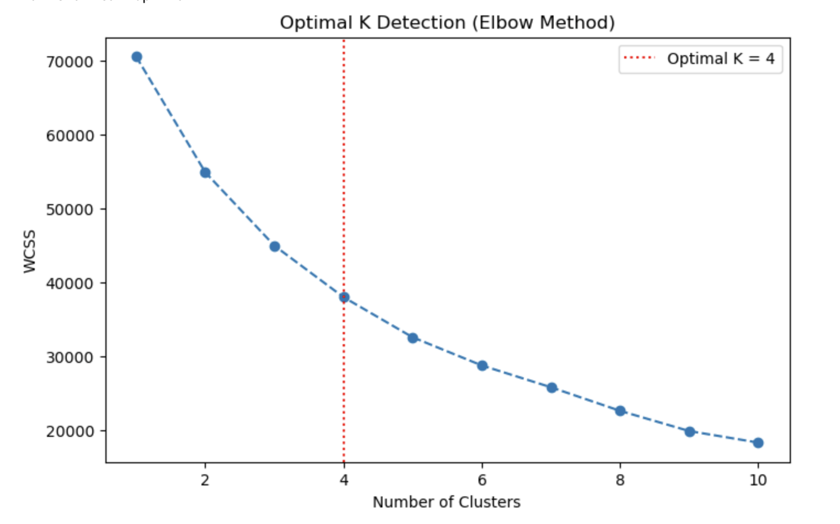
Finding Optimal Clusters
We used Within-Cluster-Sum of Squares (WCS) to measure how tight the groups are.
Using Elbow method we found K=4 to be optimal.

Slide 8
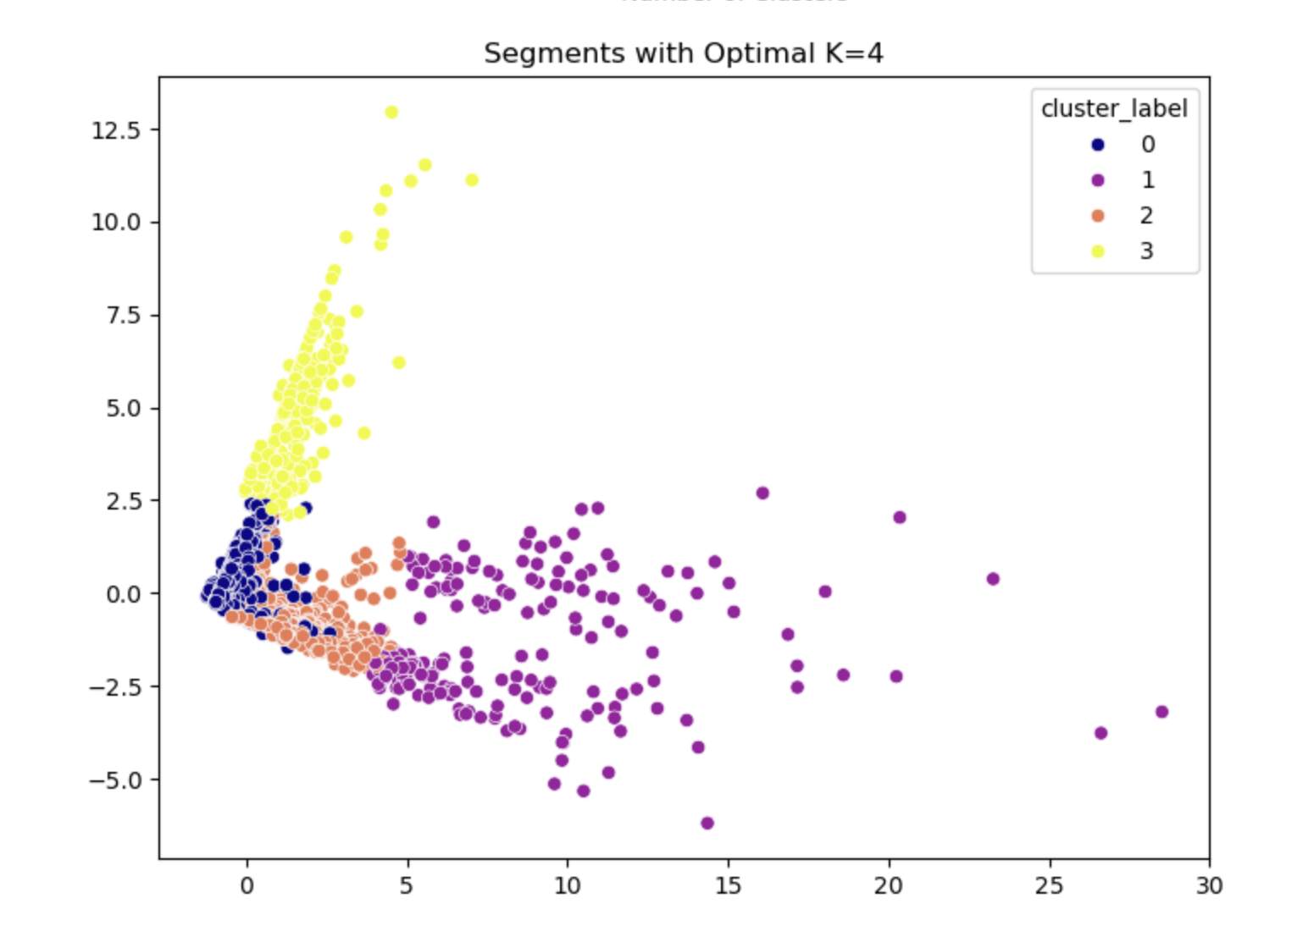
Cluster Plot Analysis
Cluster 1: Photo posts with standard, low-level engagement.
Cluster 2: High shares and loves (high quality content).
Cluster 3: Posts drew quite many comments.
Performed well on almost all metrics.

Slide 9
Recommendations
Post between 6 PM and 10 PM.
For more shares and comments use videos.
Use status updates to get quick impulse reactions.
Focus more on a certain cluster for better reactions and of course sales also.

